Slide 1
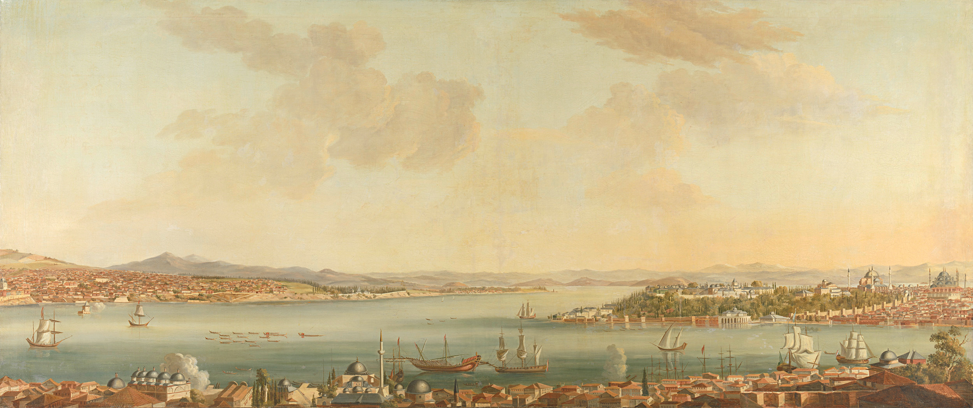

CELLULA HOTEL
by:team
An explatory data analysis about the hotel reservations dataset

Slide 2
Table Content
For this study, we will present data in :
Univariate visualisation
multivariate visualization
Interactive dashboard
Some high_accuracy ML models that predicts the booking status
A simple website that predicts the booking status

Slide 3
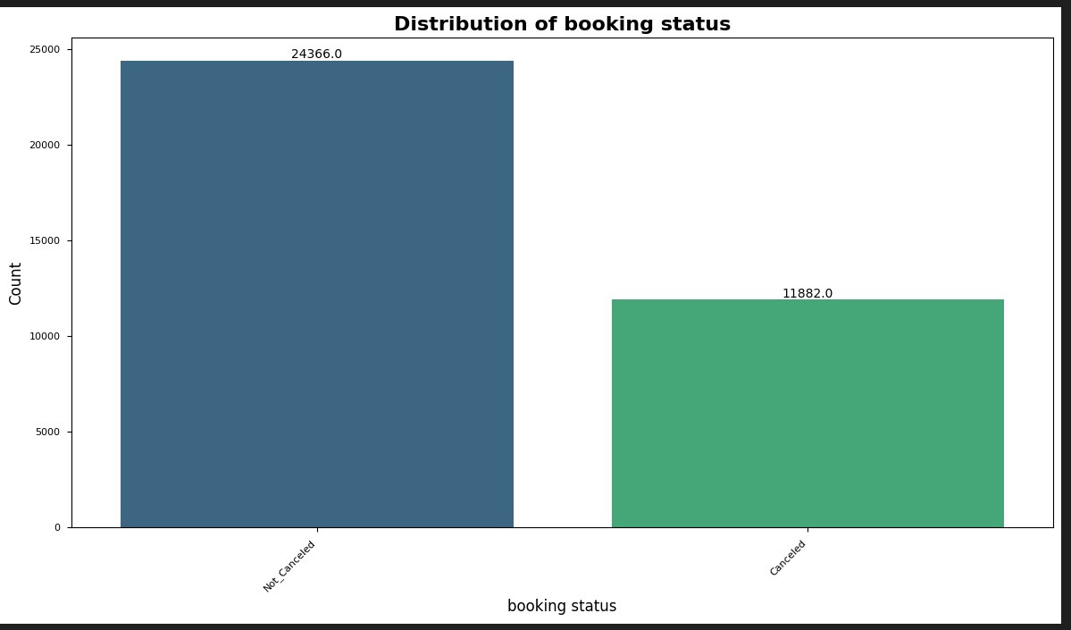
about Cellula Hotel
At first , Our hotel was Initially, the hotel was suffering from the problem of booking cancellation with a 30% percentage , and reason wasn’t known

Slide 4
Problem Statment
As There are many reasons that guests may cancel their hotel bookings. Any unoccupied rooms on any given day, hotels incur opportunity costs as well as operational costs. If the hotels allow overbookings and have more guests turn up than the total number of rooms available, hotels may incur extra costs to rearrange guests to another affliate's hotel (reduced profit margins or net loss) and may have gotten bad reviews from guests due to the bad experiences (opportunity costs from future potential guests who are considering this hotel before booking).

Slide 5
Business Solution
One business strategy that hotel managements can deploy is to do a prediction of booking cancellation. They can make use of their database of past booking records to determine the probability of cancellation using machine learning. The machine learning model can look into different guests' attributes and booking information to predict what is the probability of cancellation. This will allow hotel management to make better planning on the level of overbooking allowed as well as preparing contingency plan to transit overbooked guests to affliate hotels with prior arrangements to minimize frustration to guests' experiences.

Slide 6

Life Cycle
Exploratory Analysis
Model Evaluation
Data Preprocessing
Transforming ML model to a real world product
Data Visualization
Feature Engineering and Extraction
Model Development

Slide 7
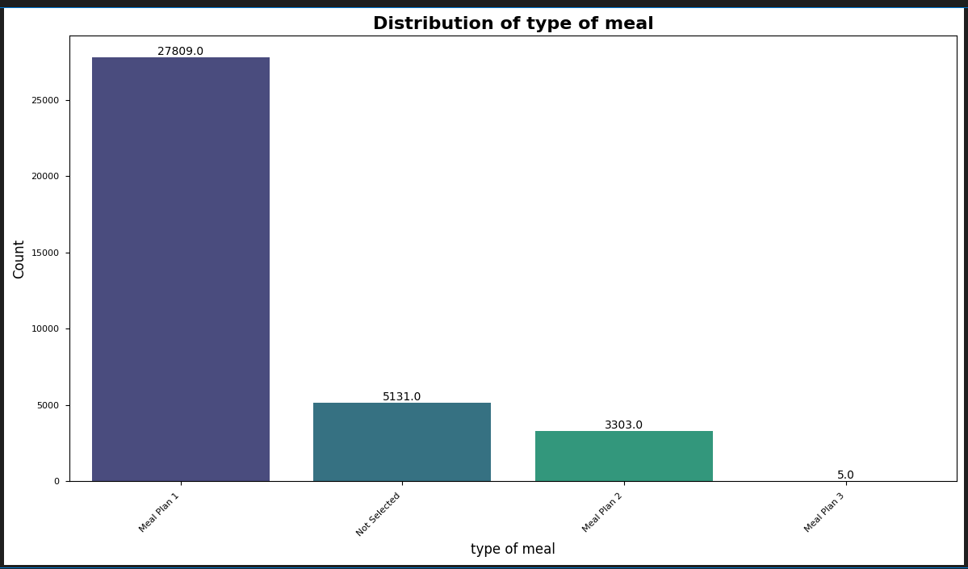
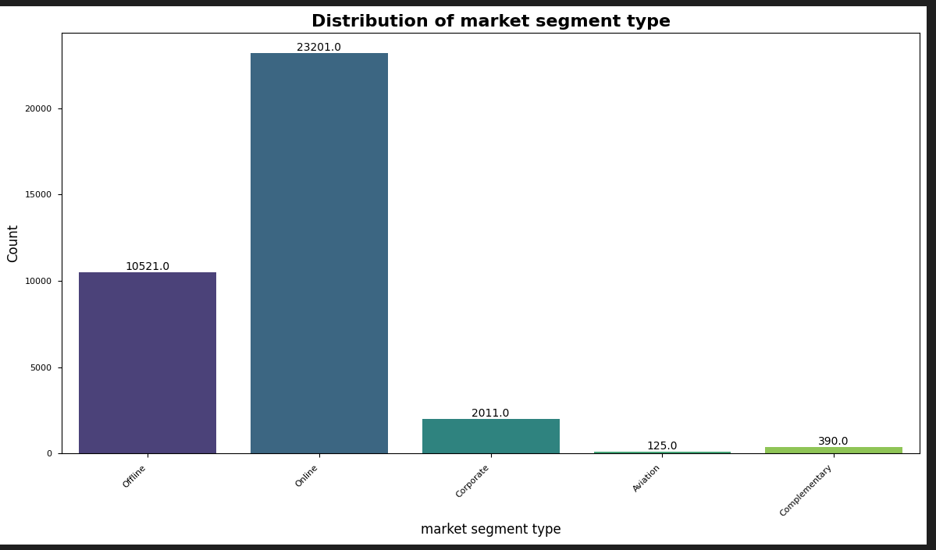
1.Univariate analysis (Bar plots)
DESCRIPTION:
These are some of our most important bar plots that represent our data variety :
The first plot shows that most customers go for meal plan 1.
The second one shows that online reservations are dominant.

Slide 8
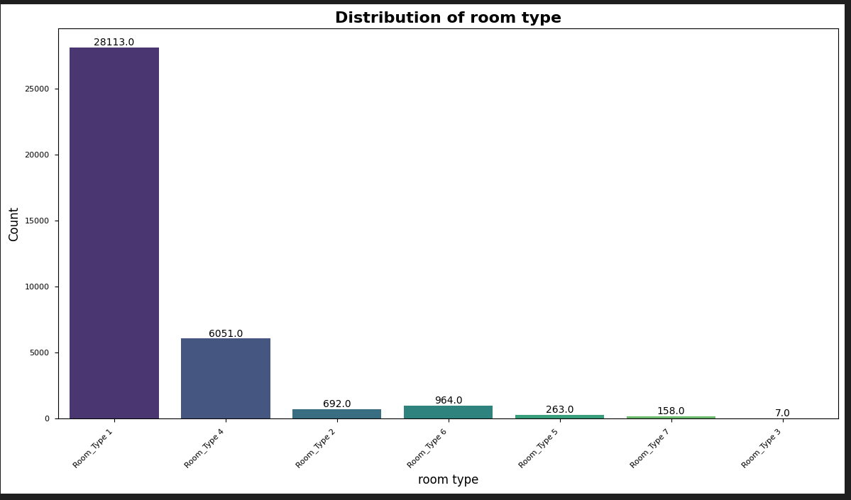
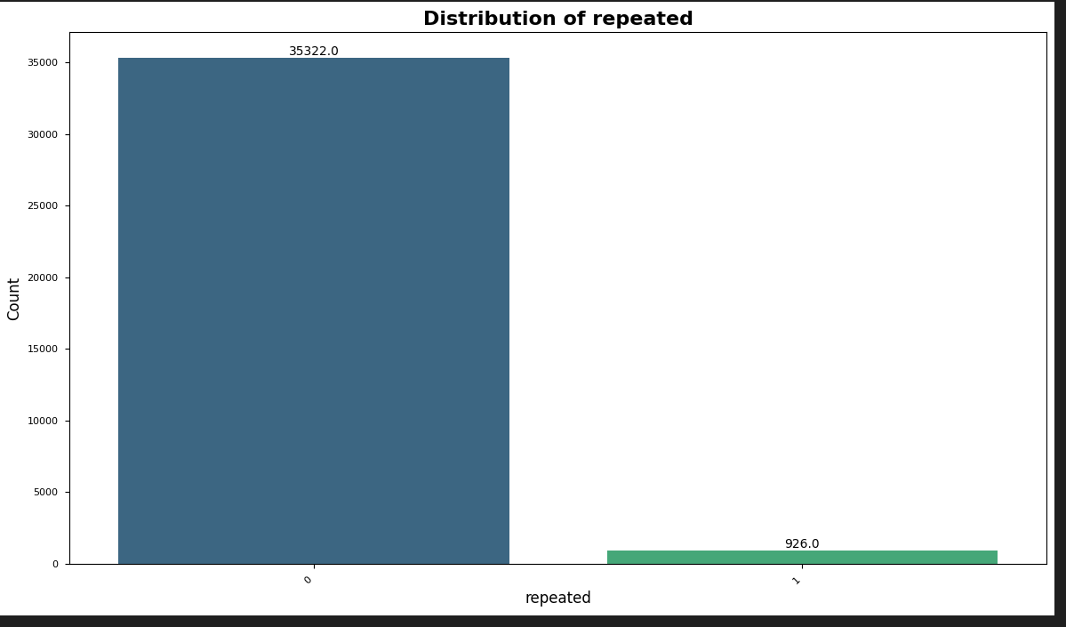
1.Univariate analysis (Bar plots)
DESCRIPTION:
These are some of our most important bar plots that represent our data variety :
The first plot shows that most customers go for room type 1.
The second one shows that so few of our customers revisit us.

Slide 9
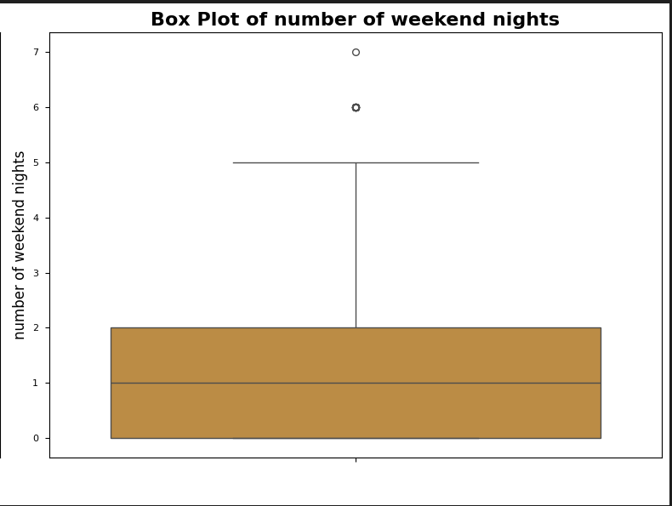
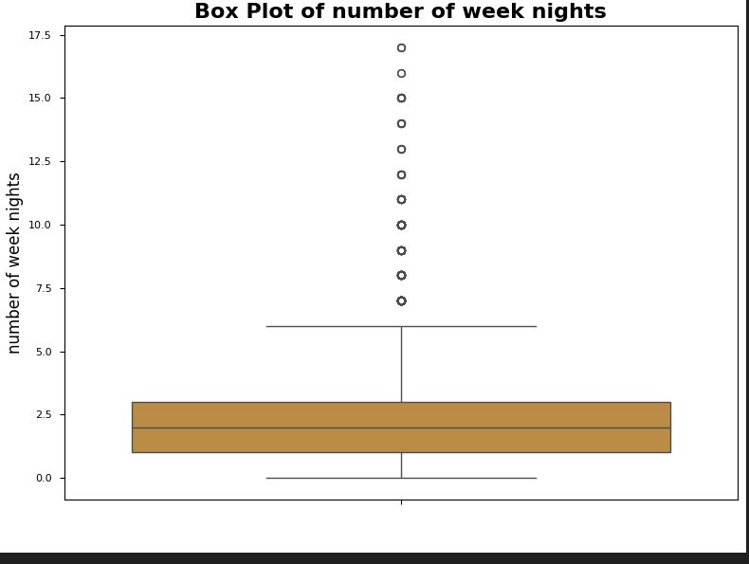
1.Univariate analysis (Box plots)
DESCREPTION:
The box plot for weekend nights shows a median around 1-2 nights, with some outliers extending to 6+ nights.
The box plot for weeknight stays indicates a wider range, with a median around 2-3 nights and numerous outliers extending up to 15+ nights.

Slide 10
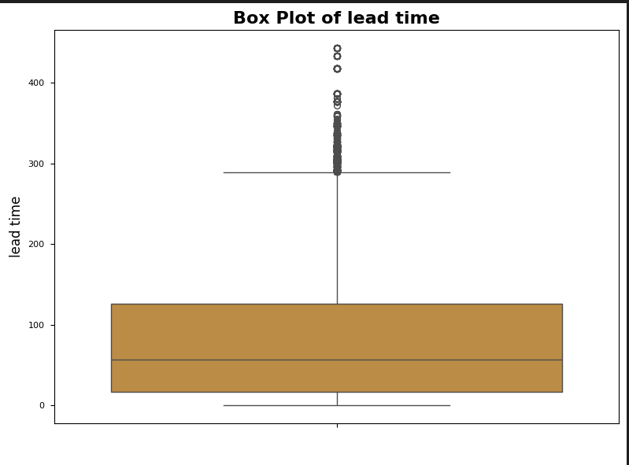
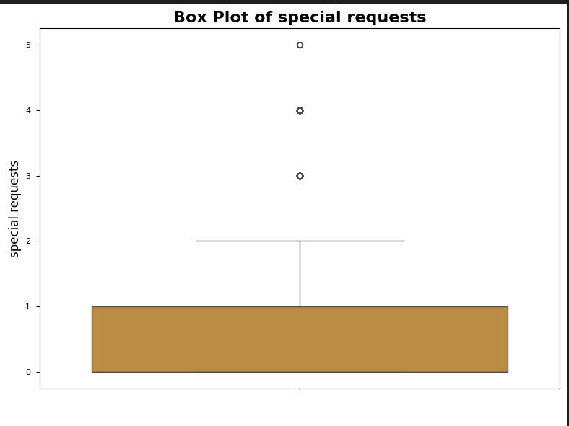
1.Univariate analysis (Box plots)
DESCREPTION:
The lead time plot shows a wide range with a median around 100 days and numerous outliers extending beyond 400 days.
The special requests plot indicates most guests make 0-1 requests, with some outliers making up to 5 requests.

Slide 11
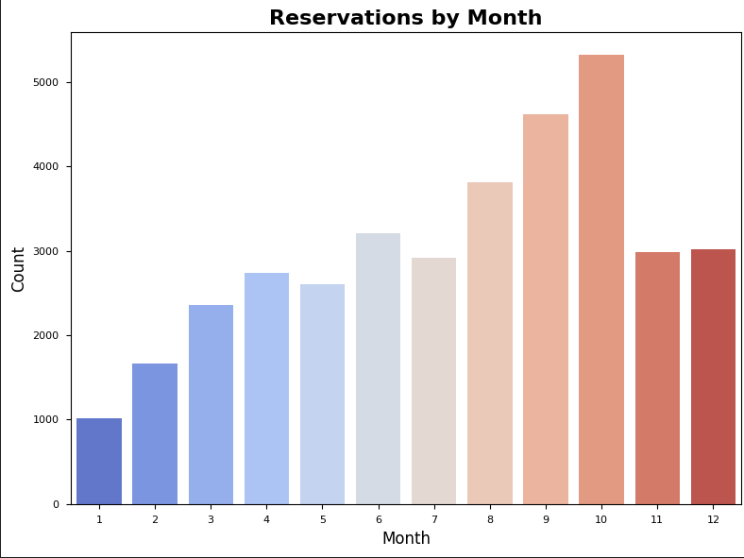
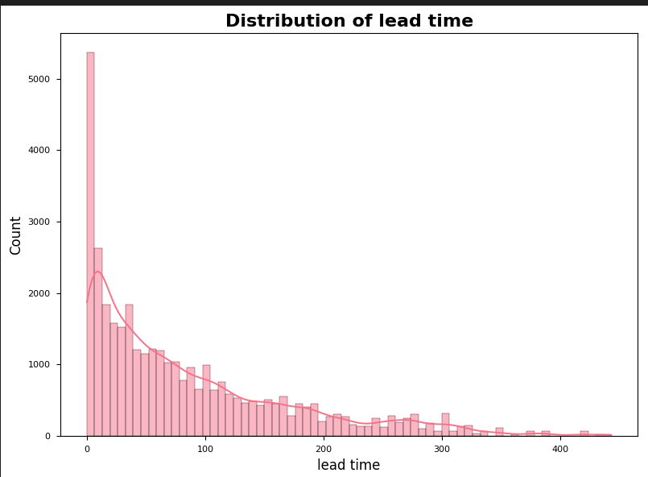
1.Univariate analysis (Important)
DESCREPTION:
The Reservations by Month plot shows a peak in August (month 8), with lowest bookings in January and a general upward trend throughout the year.
The Distribution of lead time graph displays a right-skewed distribution, with most bookings made within a short lead time and fewer bookings as the lead time increases.

Slide 12
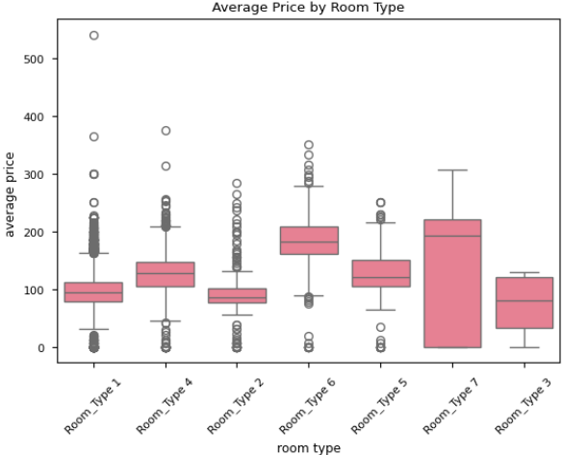
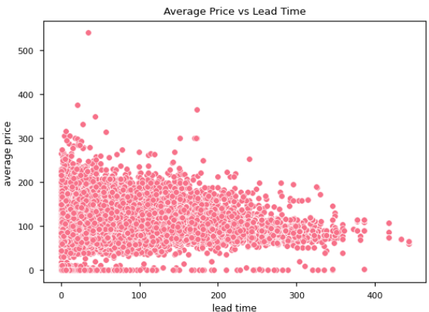
2.Multivariate analysis
DESCREPTION:
1. The Average Price by Room Type box plot shows varying price ranges across different room types, with Room Type 7 having the widest range and Room Type 6 the highest median price.
The Average Price vs Lead Time scatter plot reveals a general trend of decreasing average prices as lead time increases, with the highest prices concentrated in shorter lead times.

Slide 13
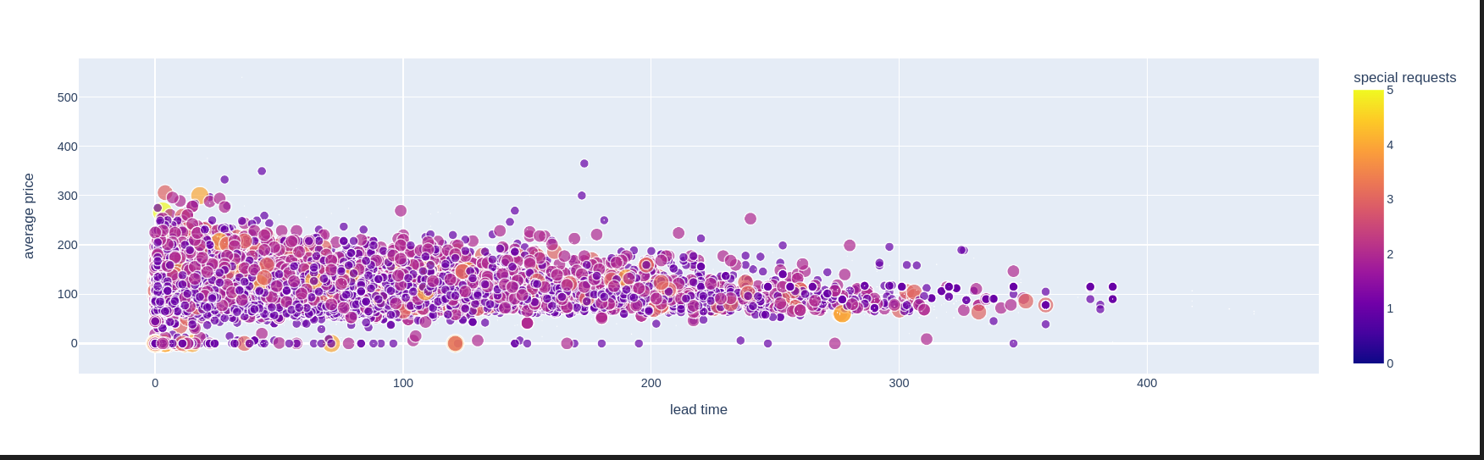
2.Multivariate analysis
DESCREPTION:
The multivariate analysis shows varying average prices across different room types, with Room Type 7 having the widest range and Room Type 6 the highest median price. A scatter plot reveals that average prices decrease as lead time increases, with higher prices concentrated in shorter lead times. The size of the data points in the scatter plot correlates with the number of special requests

Slide 14



Most influential factors
lead time
strong positive correlated with booking status
Special Requests
strong negative correlated with booking status
average price
positive correlated with booking status

Slide 15
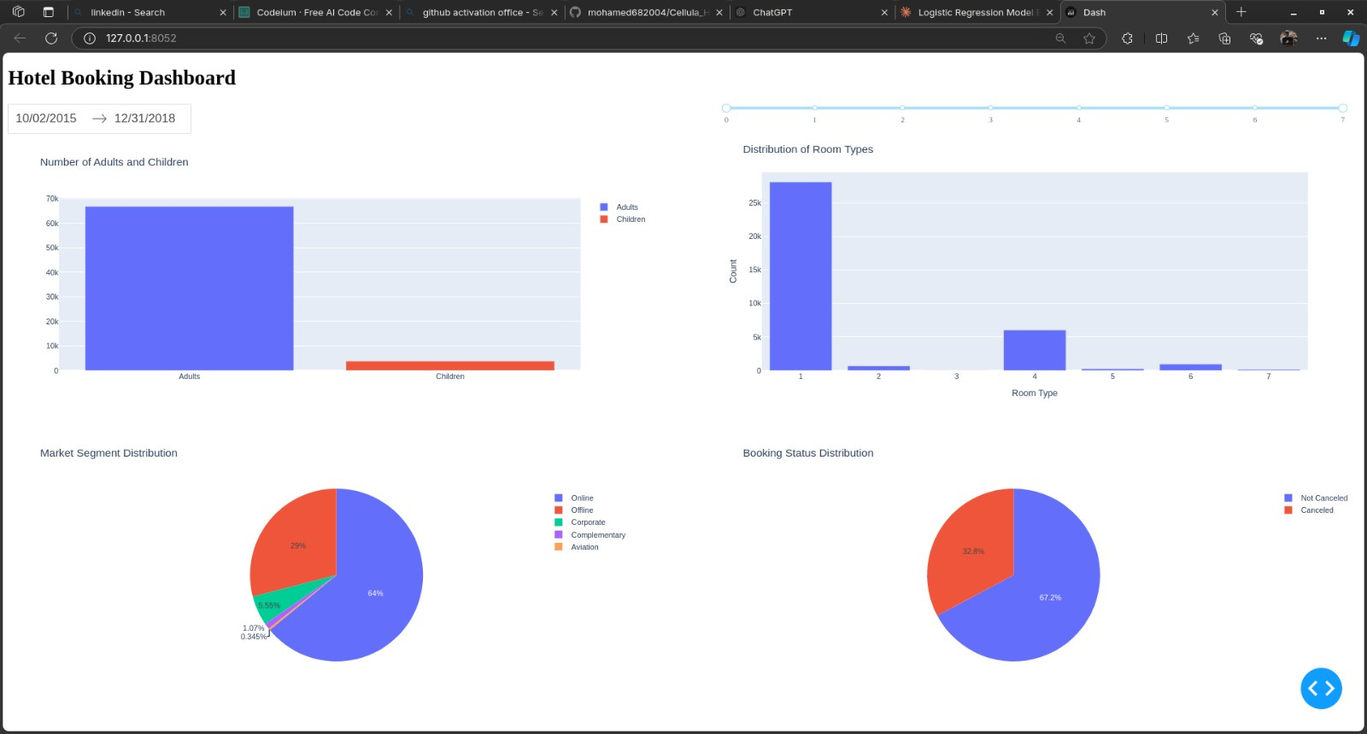
Interactive Dashboard
The dashboard displays a Hotel Booking Dashboard with various charts and graphs:
A bar chart showing the number of adults and children
A bar chart displaying the distribution of room types
A pie chart illustrating Market Segment Distribution
Another pie chart showing Booking Status Distribution

Slide 16
Model Development
Classification
Logistic Regression
Logistic Regression model for predicting the booking status where the customer will cancel the reservation or not , and model provide a percentage of 80 % for accuracy .
Grid search cv algorithm
The Grid Search algorithm achieved an overall accuracy of 89%, accurately classifying most instances. It performs well for class 0 (precision 91%, recall 93%) but is slightly less effective for class 1 (precision 84%, recall 80%), indicating some challenges in predicting this class.

Slide 17
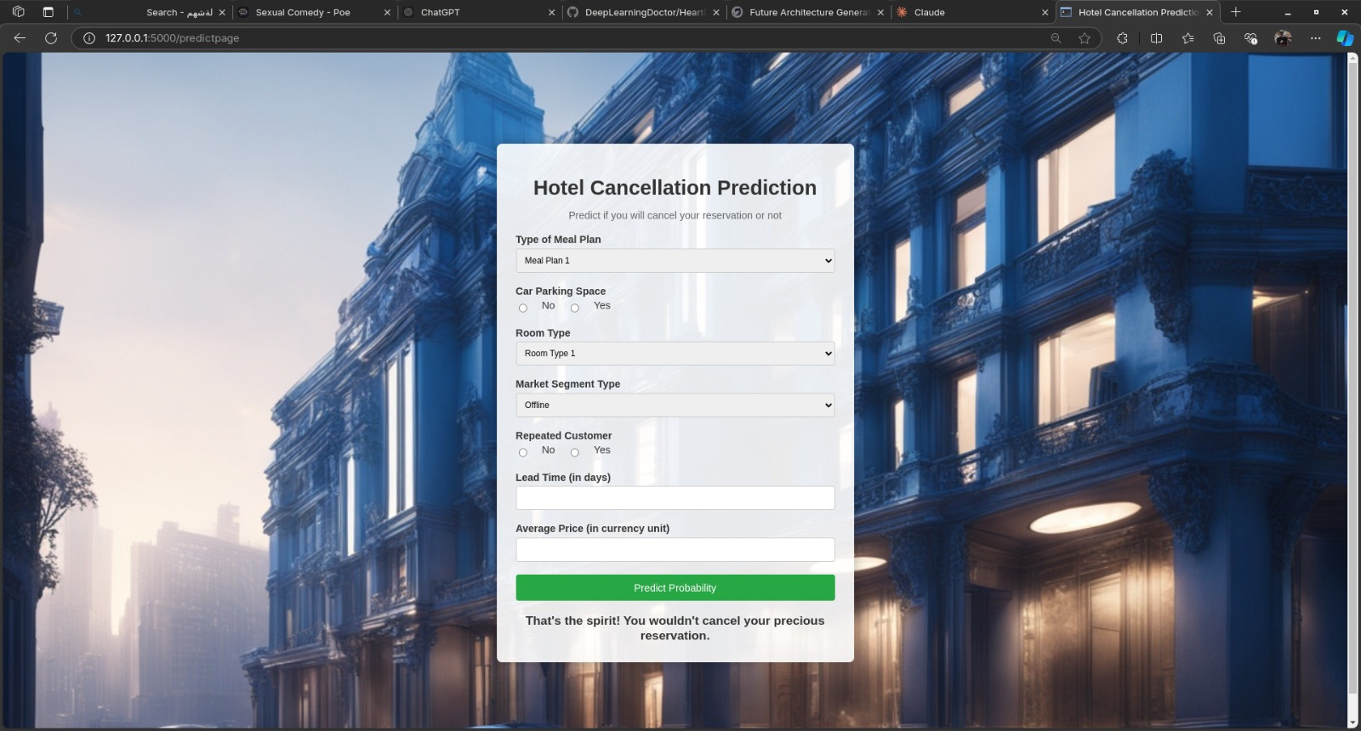
Our ML model as a product
FLASK :
Using Flask we were able to make an interactive window where user answer the questions and quickly get the predictions in which booking is cancelled or not .

Slide 18
THANKS FOR
being interested
our githup repository

